Slide 1
U of S GSA
Financial Planning Presentation
Brian Lane
Finance faculty
Edwards School of Business

Slide 2
Topics for this discussion
The importance of planning.
Borrowing and debt management
Financial survival in the education phase, and in life
Financial pitfalls

Slide 3
Personal finance horror story
From rags to riches to rags – StarPhoenix article from a few years ago
A potash worker from Moose Jaw won $2.5M in Lotto 6-49
Bought 7 luxury cars and spent money on all sorts of things.
At the time of writing he had only a mountain bike, lived with his mom, and described himself as “flat broke”.
    He still had a few pieces of his home stereo…enough, in his words, to “Make’r thunder.”
    http://ensign.ftlcomm.com/ensign2/mcintyre/pickofday/2004/december/dec18/SP_rags2rices2rags.html, July 20, 2015
Notes:
StarPhoenix article from December 17, 2004

Slide 4
That would never happen! I’ll just go out and make a lot of money!
Mike Tyson: blew through almost $300 million
NBA star Jason Caffey, with 8 years of earnings at $35 million: bankrupt in 2007
https://www.nytimes.com/2014/01/25/business/partner-in-a-prestigious-law-firm-and-bankrupt.html?_r=0, February 2, 2017
From the New York Post:
You’re in your early 20’s, you’ve just signed a multiyear/multimillion dollar contract (sports), and endorsements. You’ll likely be flat broke, bankrupt, and homeless, by the time you’re 40.
http://nypost.com/2015/06/14/how-pro-athletes-lose-everything-buying-cars-jewels-and-pet-tigers/, February 10, 2016

Slide 5
What is the #1 rule of Personal Finance?

Slide 6
The #1 rule of personal finance
“Spend Less Than You Make”
  David Chilton, excerpt from “The Wealthy Barber”
Advice from my dad, a successful business owner:
“Build your financial plan for the times where income is low. Nobody has trouble with unexpected high income”
- Excellent advice, but perhaps my dad has never read about Mike Tyson?

Slide 7
Step 1: Developing the Financial Plan
Establish your goals (SMART)
  Specific
  Measurable
  Action oriented
  Realistic
  Time bound
Consider your current financial position
Evaluate potential plans and choose one
Evaluate your progress
Revise your plan

Slide 8
Is planning important?
Many people are not financially prepared for major events in life. Think about the money required for:
  University, Work life, Giving, Cars, Homes, Vacations, Kids’ education, and Retirement
What about insurance?
Is a financial plan difficult to prepare/maintain?

Slide 9
Is planning important?
Pensions are becoming less common
Education is expensive
Governments are spending less on our needs (increased co-pay)
Increased taxation
    http://www.taxtips.ca/taxrates/sk.htm
Inflation
We’re living longer
Affluent lifestyle choices
  Is there still a distinction between needs and wants?
We need to establish good habits

Slide 10

http://www.sciforums.com/threads/jokes-and-funny-stories-ii.140862/page-45, June 9, 2015

Slide 11
Step 2: Think about liquidity
Liquidity: What is this?
  This is how quickly & easily we can convert something into cash.
  Banking services
Emergency fund: Is this possible? What do you do, when you suddenly need a significant amount of money?
Credit management: Why?

Slide 12
But life as a student is hard! It’s also expensive!
Life as a student involves spending and low income.
Is high debt and high financial stress mandatory/unavoidable?
Maybe...but maybe not to the extent you might think…

Slide 13
Post secondary student spending areas
Tuition: fixed
Books: variable
Rent: variable
Groceries: fixed, with some flexibility
Dining out: variable, luxury good
  How much does a homemade meal cost? What about a restaurant meal?
  How much do you spend daily on coffee, snacks, restaurant meals? Do you know this number?
Gas/insurance/maintenance: variable. Could you get around town, without a car?
Mobile plan, mobile data, home internet, TV/Movie packages: variable
Entertainment/recreation: variable
Others?
Notes:
Cheap car Per month
Capital cost, 4 years $ 250
Fuel $ 100
Maintenance $ 75
Insurance $ 75
Total $ 500

Slide 14
Are you interested in an enormous money sucking vacuum cleaner?

Slide 15
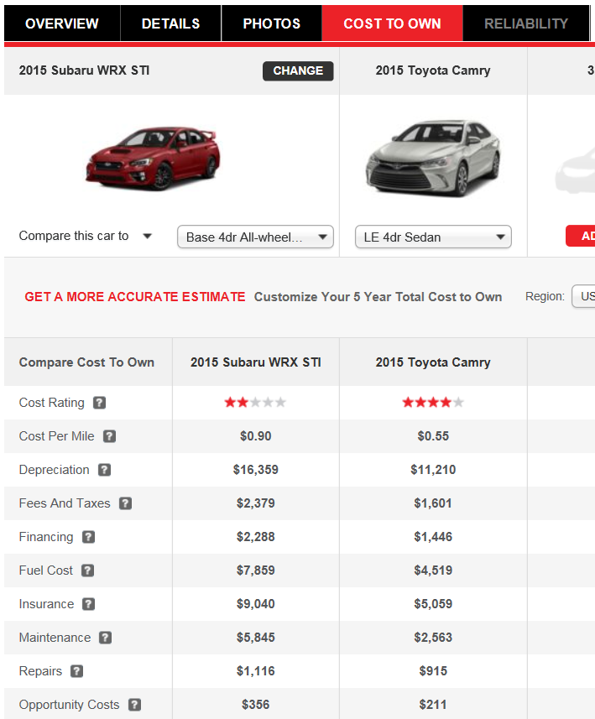
How about a car?
http://www.autoblog.com/cars-compare?cur_page=cto&v1=USC50SUC181A0&v2=USC50TOC021A0&v3=&v4=&v5=&v6=&v7=&v8=&v9=#reliability, June 5/2015

Slide 16
Another money sucker: coffee and restaurants
Daily coffee: $1.69
Daily treats: $1.60
Restaurants (weekly): $34.00
What if we cut this in half and saved the other half for 3 years at 3% interest? Future value: $4,667.25
What if we stopped spending this entirely and invested it instead? Value: $9,334
My personal financial planning students call restaurant meals “luxuries”.
The little things add up! Coffee at home = $0.05. At Tim’s = $1.69. At Starbucks = $29.99…ish

Slide 17
Who said that?
“If you can, you will quickly find that the greatest rate of return you will earn is on your own personal spending. Being a smart shopper is the first step to getting rich.”
  Mark Cuban
  http://www.lifehack.org/articles/money/26-personal-finance-tips-from-famous-people.html, February 19, 2016

Slide 18
Survival strategies
Switching to cash-only (I.E. “No Credit!”)
Planning carefully
Having an emergency fund
Part-time work can help, provided your education is not hindered.
Have you heard of deferred gratification?
  Take a look at the Stanford Marshmallow Experiment. The kids that could wait ended up better off throughout their lives.

Slide 19
Survival strategies
Tracking the past and planning for the future:
Understand how much is available.
  Some bank accounts will categorize your spending. Apps can help.
Understand how much is going out.
Control the difference
  Pay bills when they are due and avoid interest.
  Work the same way that Canada Revenue Agency does when it collects taxes:
  Automate your savings
  Automate your giving.
  If you still have difficulty controlling outflows, switch to cash.
    http://www.gailvazoxlade.com/ is a good resource.
Notes:
Examples:
Mint.com/Canada
GNUcash
Wallet

Slide 20
Financial statements
Personal cash flow statement
Accountants make these complicated
In personal finance these are simpler
  Record inflows
  Record outflows
  Look at the difference
What can be done if the net is negative?
What can be done if the net if positive?
Is there another way? (Think about our earlier discussion)

Slide 21
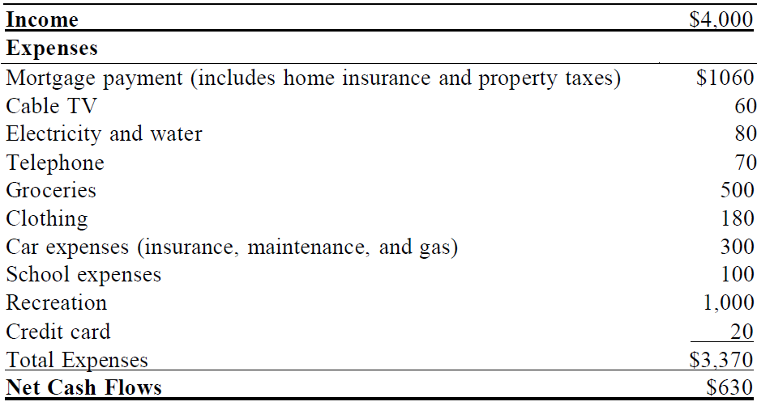
Cash flow statement example
Source: Personal Finance, Madura & Gill, 2nd Canadian Edition, Ch.3

Slide 22
The Balance Sheet
Also known as “The Statement of Financial Position”
What do we have that is valuable?
  Cash, short term savings, furniture, technology, cars, houses
How much of these valuable things do we own?
Do we owe any money?

Slide 23
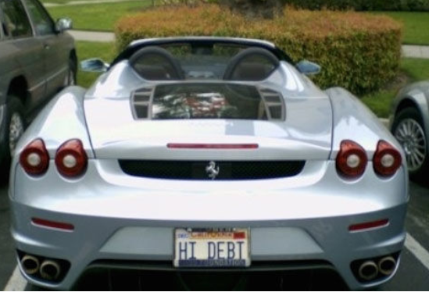
Have you ever met someone with a nice car? Were you impressed?
Car owner #1:
  Value = Loan + Portion Owned
$250,000 = $0 + $250,000
Car owner #2:
  Value = Loan + Portion Owned
$250,000 = $230,000 + $20,000
http://ca.complex.com/sports/2014/04/clever-license-plates/, February 10, 2016

Slide 24
So: who’s in love in this room?
Falling in love could cost you over $60,000! Some studies peg the number at over $100,000?
Is love therefore bad?
People that spend more on their weddings generally have higher divorce rates.
http://globalnews.ca/news/2503888/why-falling-in-love-could-cost-you-over-60k/, February 10, 2016
http://papers.ssrn.com/sol3/papers.cfm?abstract_id=2501480

Slide 25
And now, the topic you’ve eagerly waited for: tax!
You must file a return if you owe tax, if CRA sent a request, if you’re splitting income, if you received the Working Income Tax Benefit, disposed of property, or have to repay OAS/EI benefits.
Students can benefit from the GST/HST credit, and tuition credits
Build RRSP room

Slide 26
Step 3: Financing
Loans are often required for large expenditures
  Major Purchases & Managing loans
  High payments/short time vs. Low payments/long time
How many of you have a credit card?
  What is your interest rate? What interest rate would a successful business pay on borrowed money?
If a Big Mac costs $4.25, how many of you would willingly and happily pay $10.28 for it?
Notes:
$4.25 x (1+.247)^4 = $10.28

Slide 27
5 myths about students loans
It will be enough to pay for school.
It means you’re rich! (i.e. “free money”)
You don’t have to pay it back – ever.
A grace period is interest free.
Repayment is not negotiable.
http://www.cbc.ca/news/business/back-to-school-2015-5-myths-about-student-loans-1.3203105, February 15, 2016
The week of February 7th 2016, Paul Aker was arrested, by 4 U.S. Marshals with machine guns. He had failed to appear in court, relating to his 1987 student loan.
http://www.cbc.ca/radio/asithappens/tuesday-edition-1.3450287/armed-with-machine-guns-us-marshals-arrest-people-over-unpaid-student-loans-1.3450289, February 17, 2016
Notes:
http://www.cbc.ca/radio/asithappens/tuesday-edition-1.3450287/armed-with-machine-guns-us-marshals-arrest-people-over-unpaid-student-loans-1.3450289
This was in Houston, TX
Paul’s loan was originally $1,500 (taken in 1987)
In 2007 Paul was sued by the federal government for $2,600. He did not appear in court. He was arrested not for a small student loan but for failing to appear in court.
http://finance.yahoo.com/news/paul-aker-us-marshal-student-loan-debt-arrest-212047386.html
With interest, Aker owed $5,700, plus the judge wanted an additional $1,300 for gas and manpower related to the arrest.
When the marshal first called his name from outside the house, Aker ran to get his gun. Aker wondered: “What if this had been early in the morning and you startled me, and I reached for my gun? I would have been shot for $1,500.”

Slide 28
Mortgage financing
  *What else can we do, to reduce the amount we pay on a mortgage?

Slide 29
Should I save/invest or pay down debt?
You should do both
  Is that even a real answer???
Start an emergency fund
Get your “savings train” rolling
Pay down non-deductible debt
Don’t stop the savings train
Pay down deductible debt, focusing on the highest rate debt first
Keep “paying yourself first”

Slide 30
Step 4: Risk Management
In Saskatchewan auto insurance is mandatory
What about home insurance? According to SGI, homeowners “should consider” purchasing insurance
It’s a really good idea

Slide 31
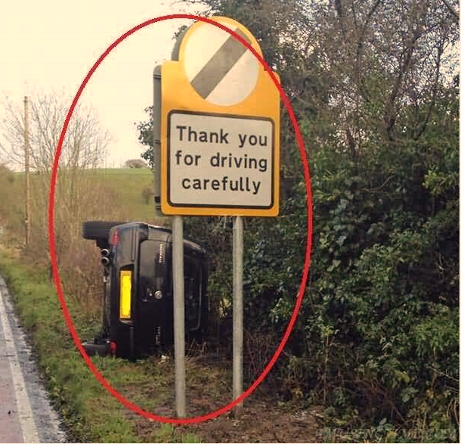
SGI requires autos to be insured, for good reason:
http://www.totifun.com/wp-content/uploads/2013/11/Funny-Road-Sign-Thank-You-For-Driving-Carefully.jpg, February 23, 2016

Slide 32
Protecting assets and income
What is your most valuable asset?
Your ability to earn income over your lifetime, your “Human Capital”
Insurance available includes disability, critical illness, and life.
A broker can help

Slide 33
Step 5: Investing
When you have excess funds (insert dramatic pause)
  These will probably appear, at some point in your future.
Stocks, bonds, mutual funds, real estate
Mutual funds are important, for many Canadians
All investments have some level of risk
Investment risk: uncertainty surrounding the potential return on an investment and its future potential value

Slide 34
Examples: Time value of money
1. Save $100 per month for 30 years, increasing this with inflation and earning 6.5% every year. Future value = $146,293
2. Same scenario, starting with $125 per month: Future value = $272,688

Slide 36
Step 6: Retirement and Estate planning
Insurance planning (dependents and tax)
Retirement planning
Post-retirement years
Estate planning
  Wills
  POAs
  Estate/Probate
How many of you currently have a will? When might you need one?

Slide 37
For further discussion
Email: Brian.Lane@usask.ca

